Slide 1
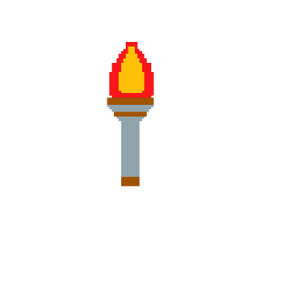
Group 12 – Dungeon Crawler
KATIE MILLAR, STEFAN SIMULETE, ALEXANDER MOORE, DANIEL BAILEY

Slide 2
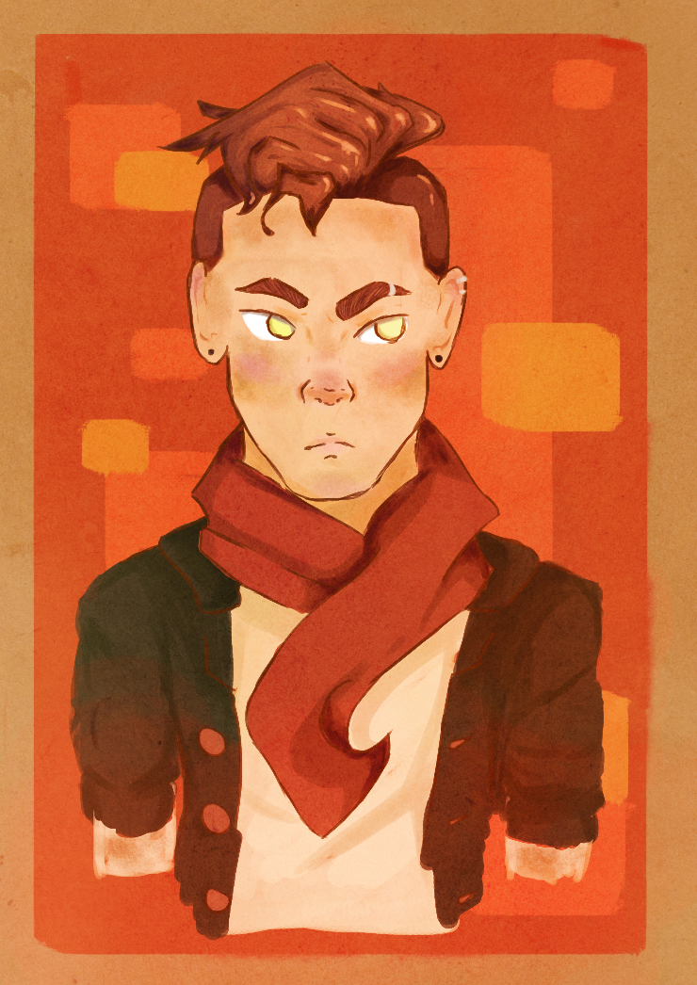
The Brief
Single-player
Developed without core
mechanic of genre
Substitution of core mechanic
with a new, refined mechanic

Slide 3
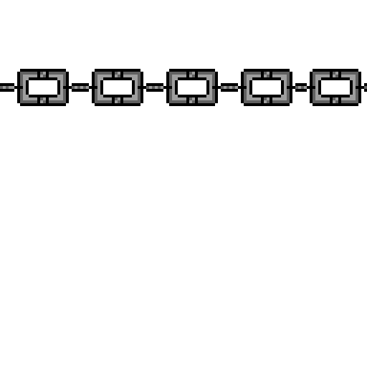
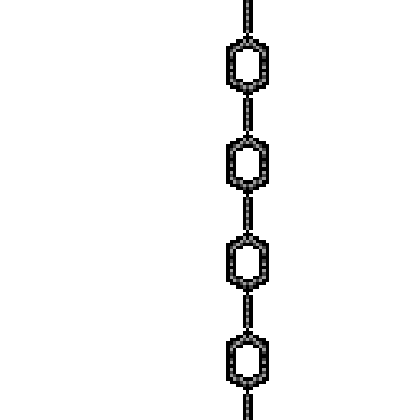
Our response to the Brief
Single-player Dungeon Crawler.
Shooting Mechanic Removed – instead players lay traps.
What does the player do?
The player avoids direct confrontation, resulting in a feeling of powerlessness.
Players plan out actions to exploit enemy patterns.
The player dodges enemy fire and must avoid getting hit, requiring planning in a stressful situation.
The player must engage in long term planning as traps take time to place.
We are hoping that players experience…
Panic, when plans go wrong and the player evades capture.
Exhilaration, successfully carrying out a plan makes the player feel smart.
Tension, constant threat of detection.

Slide 4
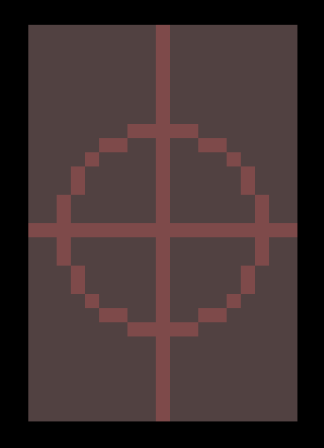



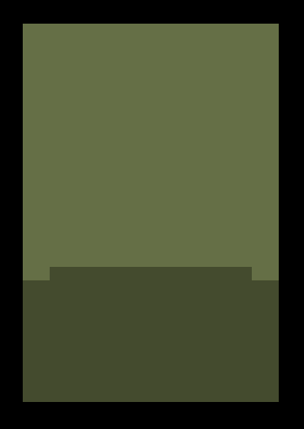
Core game loop
Player watches enemy movement and places traps in their path
Enemies are trapped
Player progresses to the next room.

Slide 5
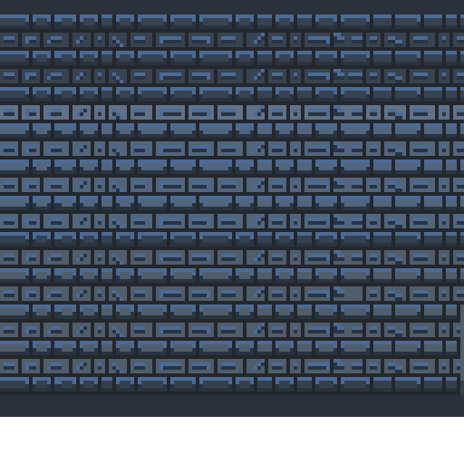
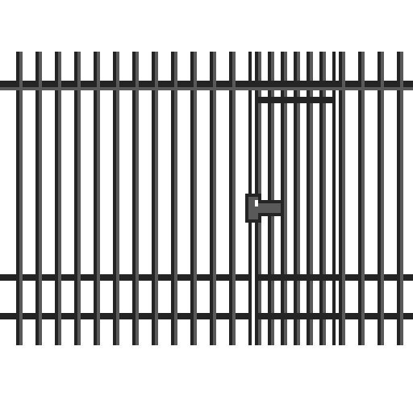
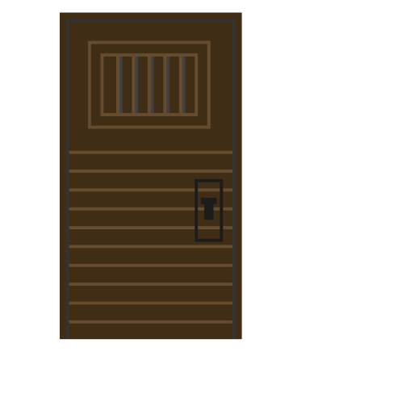
Programming Challenges
Completed Features
A* Pathfinding
Trigger overlaps
Movement changes
Unity Crashes
Player Movement
Enemy movement after finding player
Enemy interacts with traps
Starting traps break before kill
Bullet Launch
Bullet Collisions
Player health
Game over- HP 0 – Temp: Stop time
Player Placing Traps
Features to add
Trap progression
Trap Pickups
Level Building/ progression
Camera scroll into next room
HUD
Menu
Timer
High Score

Slide 6
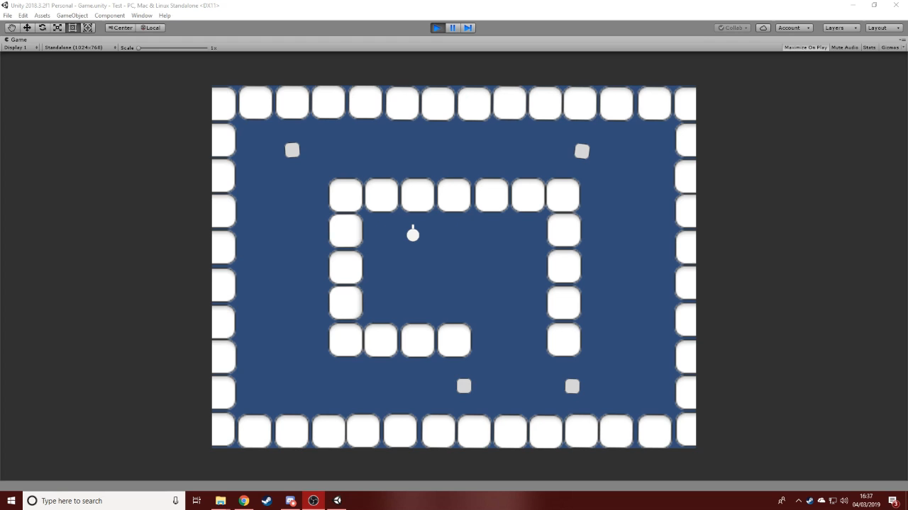
Video Footage https://www.youtube.com/watch?v=s_Xbu2oS5c0&feature=youtu.be

Slide 7
Final Deliverables
At least 3 levels, with a potential 4th ‘Boss Fight’ (Harder) level.
A complete tileset to populate levels with.
A complete, working HUD.
Fully animated player character and enemies.
Full, working programming elements.

Slide 8

Any questions?

